Slide 1
Using Node-RED to Bring IBM Domino Content into Your Web and Mobile Applications — Scott Good scott.good@us.ibm.com

Slide 2
Please note
IBM’s statements regarding its plans, directions, and intent are subject to change or withdrawal without notice and at IBM’s sole discretion.
Information regarding potential future products is intended to outline our general product direction and it should not be relied on in making a purchasing decision.
The information mentioned regarding potential future products is not a commitment, promise, or legal obligation to deliver any material, code or functionality. Information about potential future products may not be incorporated into any contract.
The development, release, and timing of any future features or functionality described for our products remains at our sole discretion.
Performance is based on measurements and projections using standard IBM benchmarks in a controlled environment. The actual throughput or performance that any user will experience will vary depending upon many factors, including considerations such as the amount of multiprogramming in the user’s job stream, the I/O configuration, the storage configuration, and the workload processed. Therefore, no assurance can be given that an individual user will achieve results similar to those stated here.

Slide 3
Agenda
1
What exactly is Node-RED, and why should you care?
Demonstration!
Node-RED with Domino
Demonstration!
More details, more complex processing
Demonstration!
Q&A
2
3
4
5
6
7

Slide 4
Part 1: What exactly is Node-RED and why should you care?

Slide 5
“Why does getting data from have to be so hard?”
If you’ve ever wondered…
Domino
…you’re going to like Node-RED

Slide 6
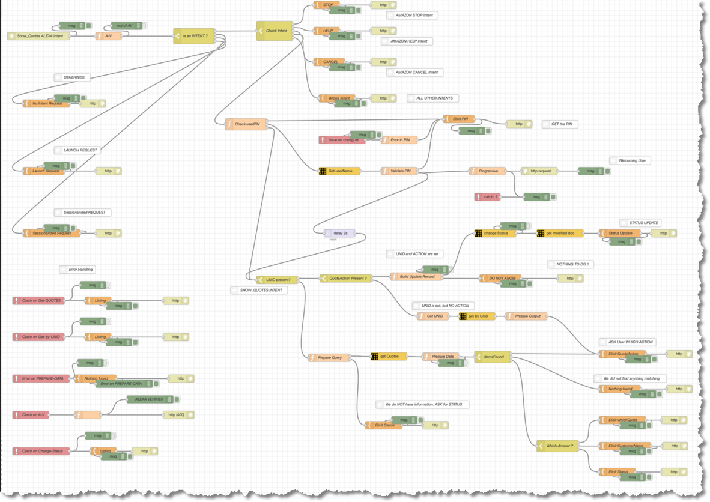
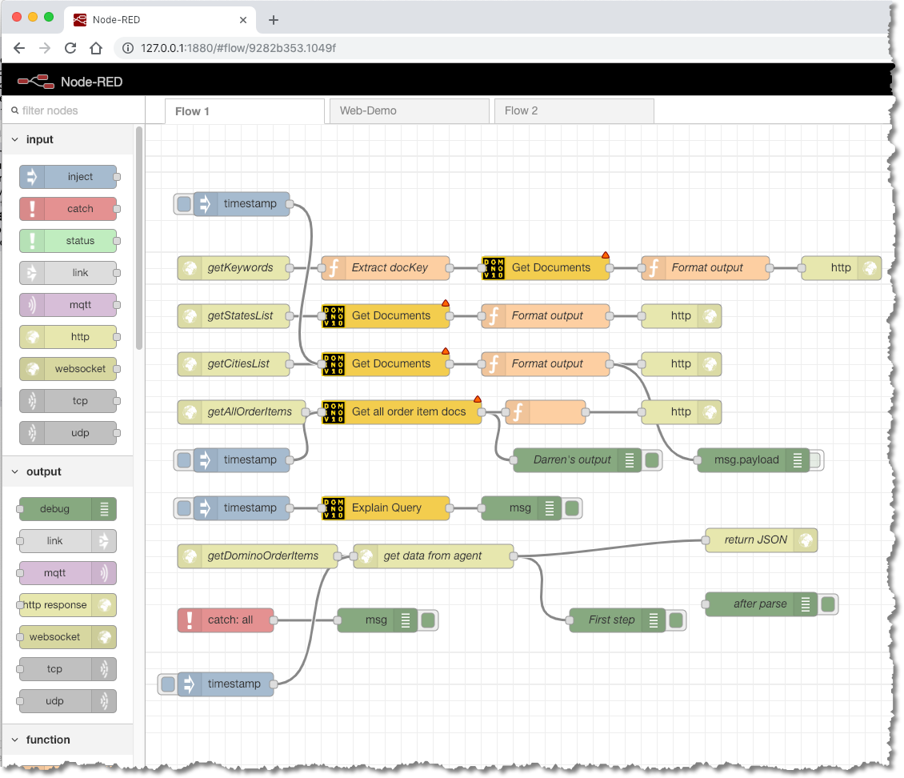
Node-RED is a flow-based programming tool
What exactly is Node-RED?
Open source visual editor
Allows programmers of all skill levels to quickly connect systems of all kinds
Originally built by IBM for managing IoT devices
Built on Node.JS
Runs in your browser
Generates JavaScript functions

Slide 7
Yeah, but…
?
is
what
it

Slide 8
Demonstration The basics of…
RED
Node
Notes:
Build simple example of Node-RED function. Maybe use online version to show twitter feed. Describe the parts of the interface. Show the debugger and msg object.

Slide 9
What does that have to do with…
?
OK, but…
Domino

Slide 10
Part 2: Node-RED (with Domino)

Slide 11
Consider this question…
Node-RED with Domino
You are building a web or mobile application outside of Domino.
You need to retrieve--from a Domino database--a list of all the names of current approvers in an unknown number of open workflow documents.
The result will be used in a drop-down list for filtering requests by approver.
How would you do it?

Slide 12
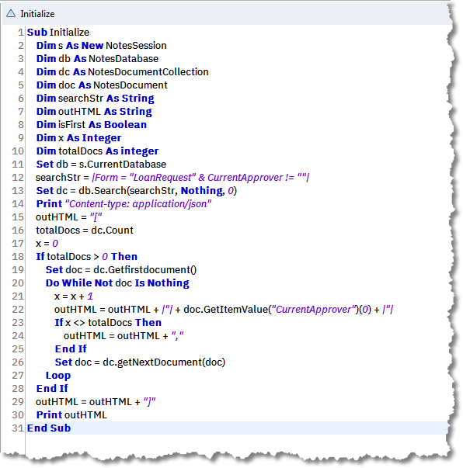
One option: LotusScript
Node-RED with Domino
If you have the Domino Designer…
…and know LotusScript…
…a LotusScript agent is a good (and time-honored) way to create a web service to access Domino content.
[This example is hard-coded to a single query and returns the value of one specific field.]

Slide 13
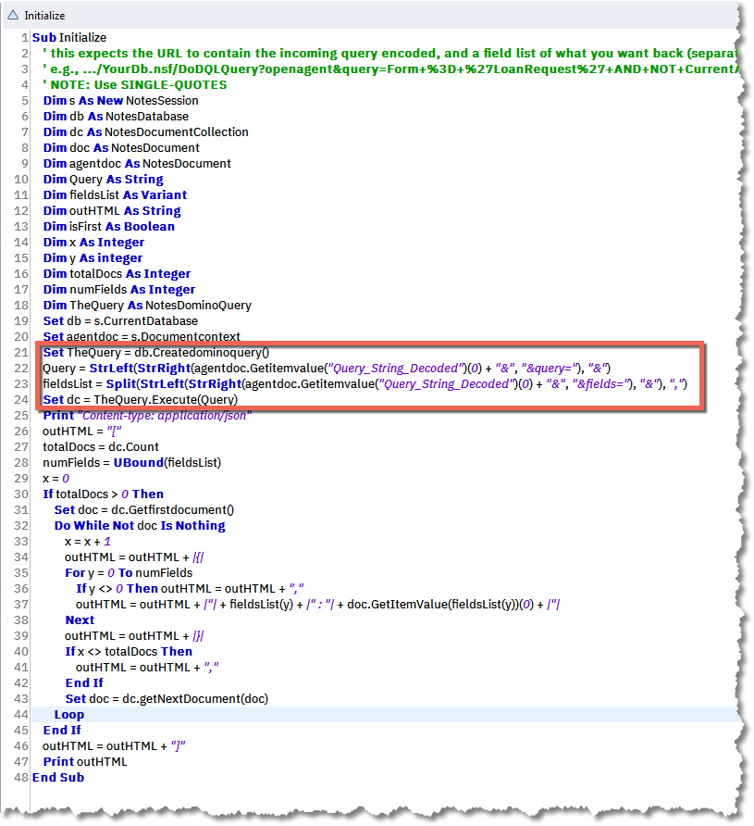
Or: LotusScript with DQL
Node-RED with Domino
If you have the Domino Designer v10.0.1…
…and know LotusScript…
…and the new DQL classes…
…a LotusScript agent is still a good (and time-honored) way to create a web service to access Domino content.
[This example accepts the query and the list of fields to return on the URL]

Slide 14
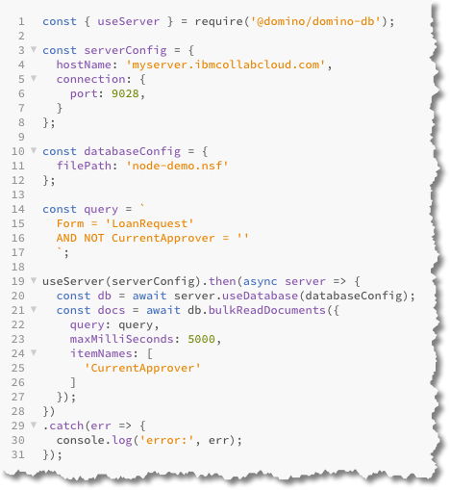
Or: JavaScript with DQL
Node-RED with Domino
Using the Domino v10 domino-db capabilities for Node.js, it’s quite possible to build a RESTful web service using plain-old roll-your-own JavaScript…
…if you know how

Slide 15
All that great at coding for Domino
?
But what if you’re not…you know…
…or just want an easier way to do it

Slide 16
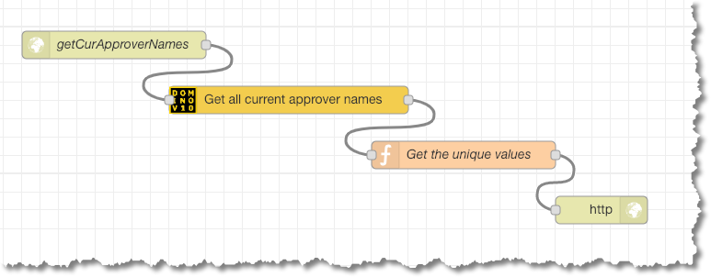
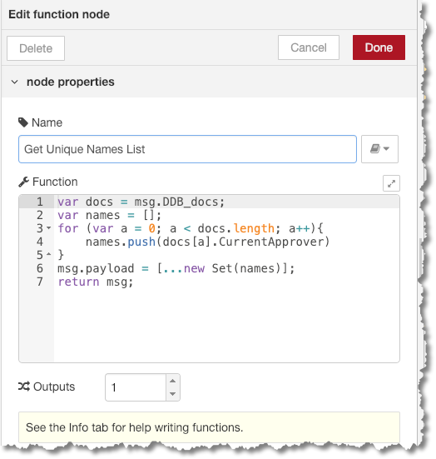
With Node-RED you’d build a flowchart
Node-RED with Domino
This is the full set of coding for a web service called getCurApproverNames
It does the following:
Accepts incoming http requests
Connects to a specified Domino workflow-enabled database
Finds all the active workflow documents, gets basic info (e.g., unid) plus the current approver’s name, and passes them along
Extracts all the names and removes duplicates
Returns the names to the calling code as a JavaScript array

Slide 17
Demonstration A simple web service
RED
Node
for Domino
Notes:
Build simple /getCurrentApprovers web service. Show how to run locally with Inject, how to debug, how to use Function and msg to parse and return what you actually want. How to use debug to see results/progress.

Slide 18
The only actual code
Node-RED with Domino
A few lines of JavaScript to extract the unique names list.
Everything else is done with simple configuration forms.

Slide 19
Just to be clear…
Node-RED with Domino
Node-RED
LotusScript

Slide 20
Part 3: More details, more complex processing

Slide 21
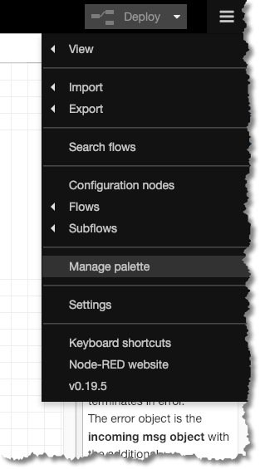
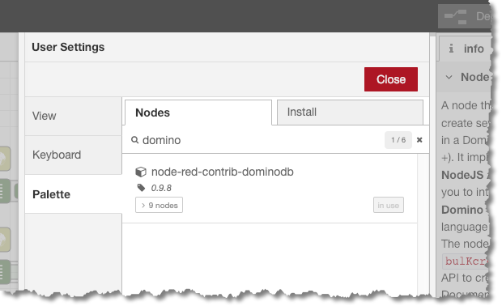
Installing the Domino 10 nodes
More details, more complex processing
From the right-side hamburger menu in Node-RED, choose Manage palette then type domino in the search area.
You want: node-red-contrib-dominodb

Slide 22
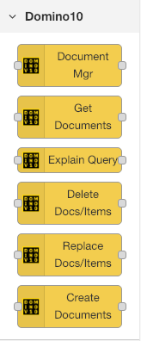
The Domino10 nodes
More details, more complex processing
Document Mgr — performs a full set of CRUD (create, read, update, delete) operations on a single document.
Get Documents — gets one or many documents. Returns basic info (e.g., unid) plus the values of specified items (fields).
Explain Query — used for development/tuning purposes only. Returns statistics regarding the query, including elapsed times.
Delete Docs/Items — does BULK deletion of documents or items from documents, e.g., delete all order records for ACME Corp.
Replace Docs/Items — replaces either documents or individual items in BULK…i.e., across one or more documents
Create Documents — creates new documents in BULK.

Slide 23
Special msg values
More details, more complex processing
DDB = Domino Database
msg.DDB_countValue
msg.DDB_displayResults
msg.DDB_doc
msg.DDB_docs
msg.DDB_documentOp
msg.DDB_documentsOrItems
msg.DDB_fatal
msg.DDB_itemNames
msg.DDB_itemValues
msg.DDB_itemValuesById
msg.DDB_maxDocuments
msg.DDB_maxMillisecs
msg.DDB_maxViewEntries
msg.DDB_query
msg.DDB_queryExplained
msg.DDB_queryOrId
msg.DDB_result
msg.DDB_startValue
msg.DDB_unid
msg.DDB_unids
The various Domino nodes can be configured to make use of numeous special additions to the msg object.
If needed for what you’re doing, you can just add them programmatically, typically by using a function node.
All of these are well documented in the domino-db nodes.

Slide 24
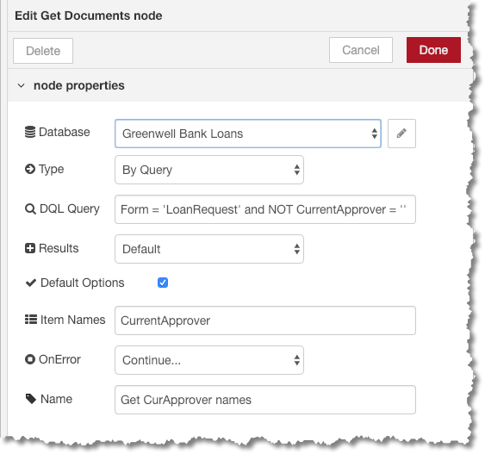
Get Documents node
More details, more complex processing
Can be as simple as filling out the form.
The setup here returns the value of the CurrentApprover field from all LoanRequest documents where that value is not empty.
Four key questions:
From which database?
How to choose?
Which documents?
Which fields to send back?

Slide 25
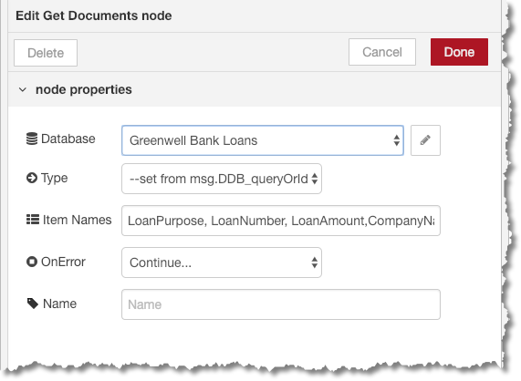
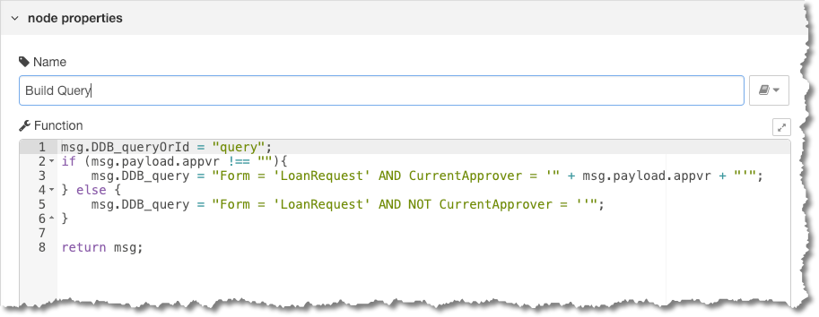
Get Documents node
More details, more complex processing
URL parameters, e.g., &appvr=John%20Doe, are automatically added to the payload object.
Or, you can use programmatic input for your DQL queries.
Requires two values added to msg:
DDB_queryOrId to determine if docs are found based on a query or UNID.
DDB_query or DDB_unids to support the choice above.
If desired, DDB_itemNames can be used to define the item names to return (not shown here).

Slide 26
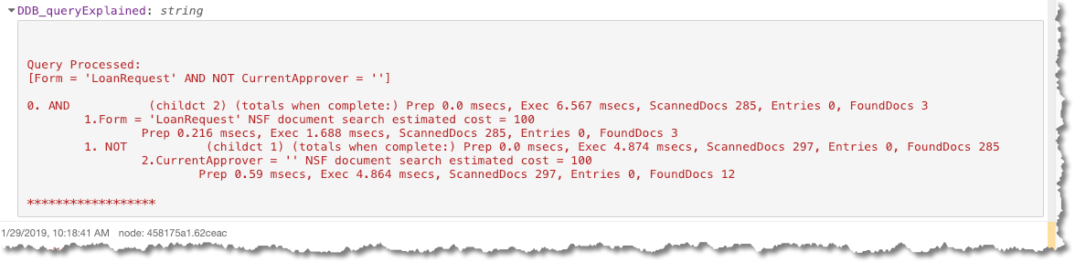
Explain Query node
More details, more complex processing
Used for development/tuning purposes only. Returns statistics regarding the query, including elapsed times.

Slide 27
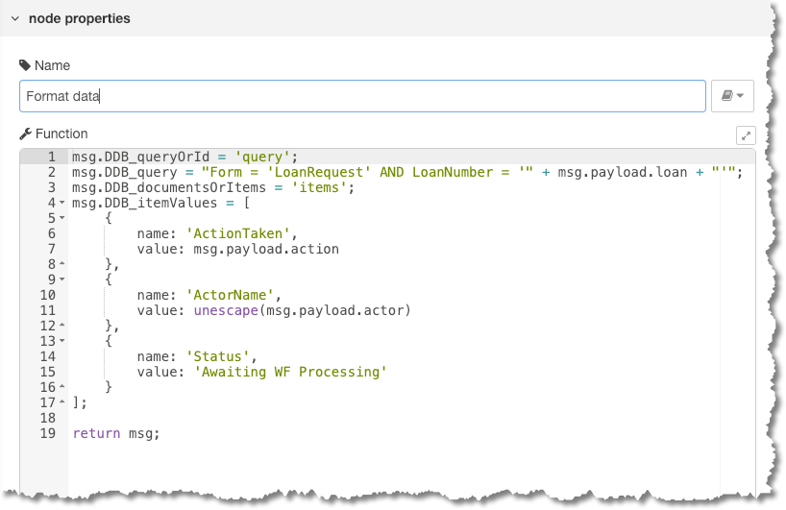
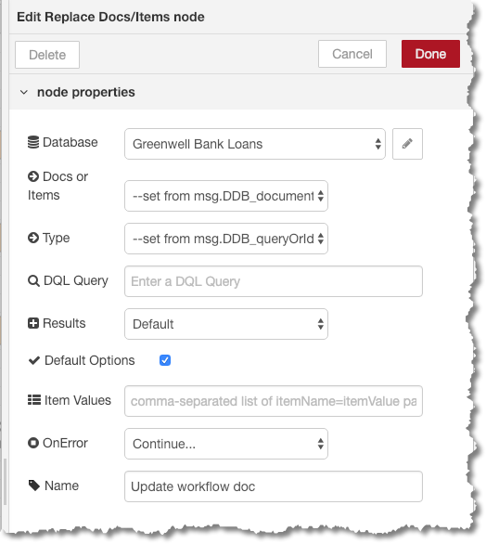
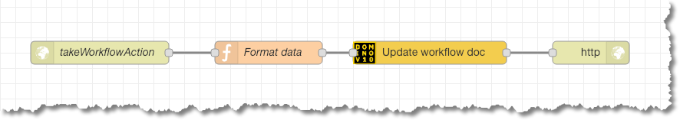
Replace Docs/Items node
More details, more complex processing
Replaces either documents or individual items in BULK…i.e., across one or more documents

Slide 28
Syntax considerations
More details, more complex processing
Booleans do not include “not equal”
NO double-quotes. Use apostrophes.
Use double-apostrophes to escape included apostrophes
Form = ‘Loan’ AND NOT CurrentApprover = ‘’
Company = ‘Joe’’s Grocery’

Slide 29
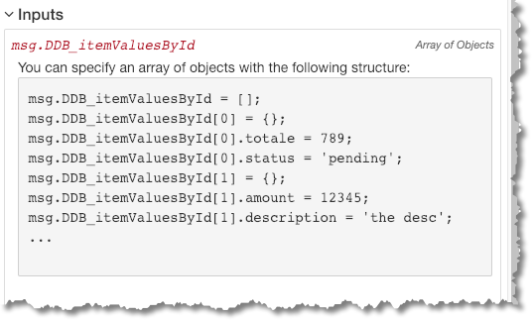
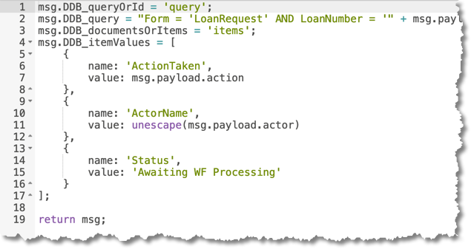
More syntax
More details, more complex processing
There are a few places in the current documentation where the instructions show the C++ approach to defining new content.
You can also use the JSON version of the same thing (which is a lot simpler to write and read)

Slide 30
Demonstration Working with Domino content
Domino
RED
in
Node
Notes:
Build simple /getCurrentApprovers web service. Show how to run locally with Inject, how to debug, how to use Function and msg to parse and return what you actually want. How to use debug to see results/progress.

Slide 31
Questions? (and, hopefully, answers)
?

Slide 32
Notices and disclaimers
© 2018 International Business Machines Corporation. No part of this document may be reproduced or transmitted in any form without written permission from IBM.
U.S. Government Users Restricted Rights — use, duplication or disclosure restricted by GSA ADP Schedule Contract with IBM.
Information in these presentations (including information relating to products that have not yet been announced by IBM) has been reviewed for accuracy as of the date of initial publication and could include unintentional technical or typographical errors. IBM shall have no responsibility to update this information. This document is distributed “as is” without any warranty, either express or implied. In no event, shall IBM be liable for any damage arising from the use of this information, including but not limited to, loss of data, business interruption, loss of profit or loss of opportunity. IBM products and services are warranted per the terms and conditions of the agreements under which they are provided.
IBM products are manufactured from new parts or new and used parts. In some cases, a product may not be new and may have been previously installed. Regardless, our warranty terms apply.”
Any statements regarding IBM's future direction, intent or product plans are subject to change or withdrawal without notice.
Performance data contained herein was generally obtained in a controlled, isolated environments. Customer examples are presented as illustrations of how those customers have used IBM products and the results they may have achieved. Actual performance, cost, savings or other results in other operating environments may vary.
References in this document to IBM products, programs, or services does not imply that IBM intends to make such products, programs or services available in all countries in which IBM operates or does business.
Workshops, sessions and associated materials may have been prepared by independent session speakers, and do not necessarily reflect the views of IBM. All materials and discussions are provided for informational purposes only, and are neither intended to, nor shall constitute legal or other guidance or advice to any individual participant or their specific situation.
It is the customer’s responsibility to insure its own compliance with legal requirements and to obtain advice of competent legal counsel as to the identification and interpretation of any relevant laws and regulatory requirements that may affect the customer’s business and any actions the customer may need to take to comply with such laws. IBM does not provide legal advice or represent or warrant that its services or products will ensure that the customer follows any law.

Slide 33
Notices and disclaimers continued
Information concerning non-IBM products was obtained from the suppliers of those products, their published announcements or other publicly available sources. IBM has not tested those products about this publication and cannot confirm the accuracy of performance, compatibility or any other claims related to non-IBM products. Questions on the capabilities of non-IBM products should be addressed to the suppliers of those products. IBM does not warrant the quality of any third-party products, or the ability of any such third-party products to interoperate with IBM’s products. IBM expressly disclaims all warranties, expressed or implied, including but not limited to, the implied warranties of merchantability and fitness for a purpose.
The provision of the information contained herein is not intended to, and does not, grant any right or license under any IBM patents, copyrights, trademarks or other intellectual property right.
IBM, the IBM logo, ibm.com and [names of other referenced IBM products and services used in the presentation] are trademarks of International Business Machines Corporation, registered in many jurisdictions worldwide. Other product and service names might be trademarks of IBM or other companies. A current list of IBM trademarks is available on the Web at “Copyright and trademark information” at: www.ibm.com/legal/copytrade.shtml.

Slide 34
thank
you
Scott Good / scott.good@us.ibm.com

Slide 35
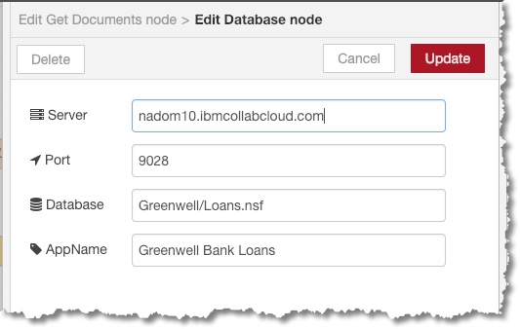

Slide 36
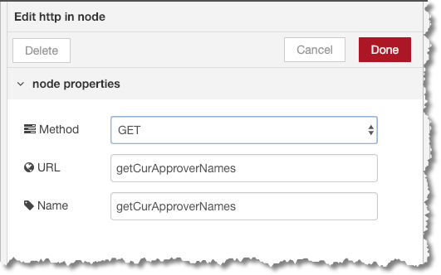
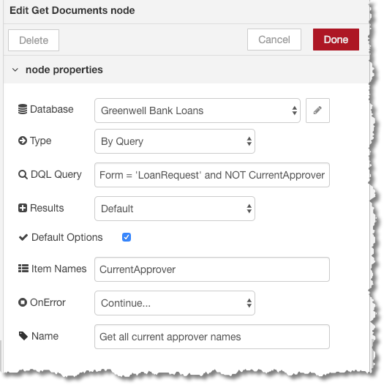
The whole thing…
Node-RED with Domino
Form = ‘LoanRequest’ and NOT CurrentApprover = ‘’

Slide 37
Start to finish: 2-5 minutes
Node-RED with Domino

Slide 38
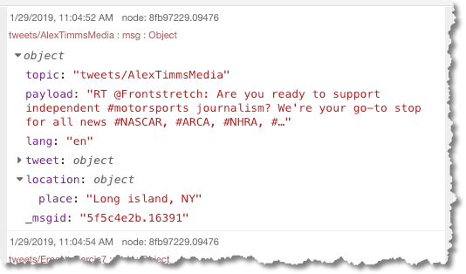
The Node-RED msg object
Node-RED with Domino
The msg object is what is moves data between nodes in the Node-RED workflow process.
It is simply a JSON object.
Most of what is used by Node-RED is msg.payload, but you can add any additional elements to payload or any other part of msg.

